Slide 1

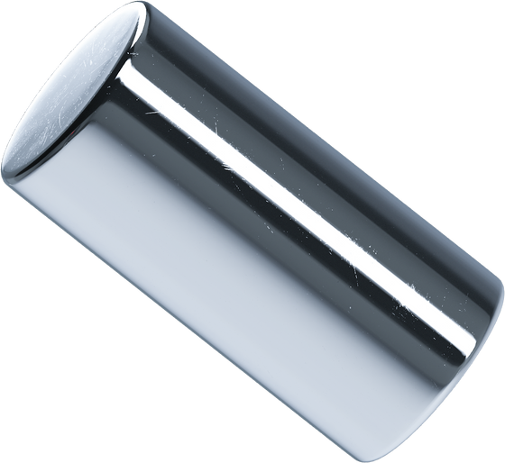
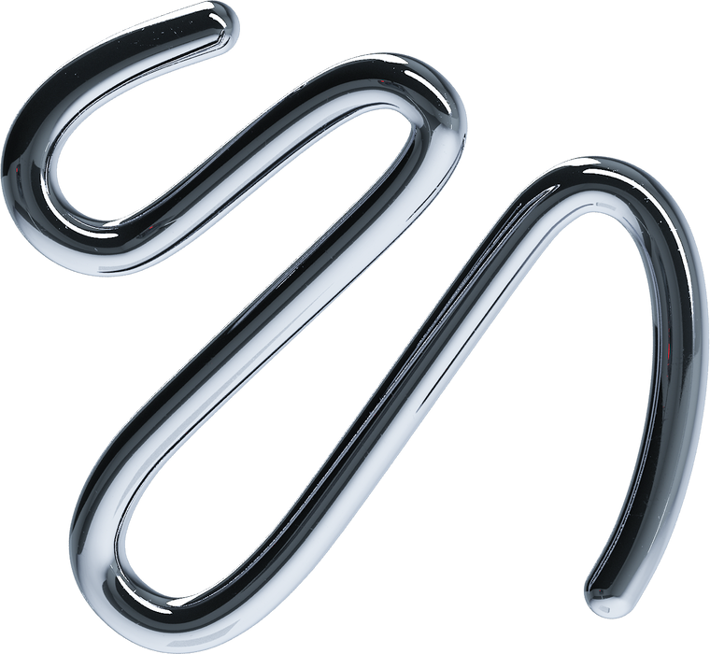
Cost Estimation for Manufacturing
Shane Carmichael, MBA, Bachelor of Mechatronic Engineering

Slide 2
Agenda
Executive Summary
Background and Nature of Business Problem
Key topics covered
in this presentation
Project Workflow
Dataset, Cleaning and Feature Engineering
Machine Learning Accuracy
Business Predictions and Outcomes
2

Slide 3

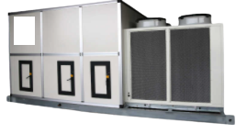
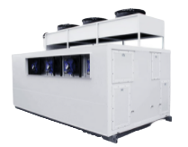

Executive Summary
PROBLEM
DATASET
How can we use machine learning to improve the speed and accuracy in cost estimation?
Historical Cost Dataset for bespoke commercial HVAC equipment
STRATEGY
MODELS
RESULTS
Create machine learning model from historical cost data to provide better estimates for future sales.
Linear Regression
Lasso Regression
Ridge Regression
Bagging with LR
Deep Learning
Random Forest
ADAboost
XG Boosting
Predicted increase in gross profit of up to 22% while reducing overhead and working capital
3

Slide 4


BUSINESS PROBLEM
Gross Profit Margin is Inconsistent Due to Inaccurate Cost Estimates
Quantitative Cost Estimation Techniques are Slow and Expensive
Production Capacity is Limited by Available Labour
Need to Avoid Under and Overpricing
4

Slide 5

Business Question
How can we quickly and cost effectively estimate the cost of projects to avoid over and under pricing?
5

Slide 6
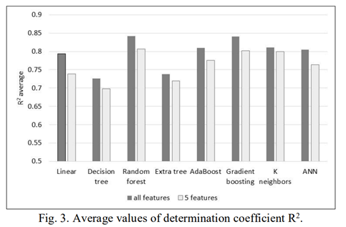
Prior Research
Rickenbacher et al. (2013)
Has this been done before?
Linear Regression CNC machined parts.
Duran et al. (2012)
ANN for cost estimation for shell and tube heat exchangers.
Kurasova et al (2021)
Multiple machine learning model in customized furniture production
6

Slide 7
Project Workflow
Clean Data
Feature Engineering
Create Models
Get Predictions
Evaluate
Clean and merge datasets
Create new features using Regex
Create ML models from dataset
Use model on historical data to obtain predictions
Quantify the benefit of the predictions
7

Slide 8
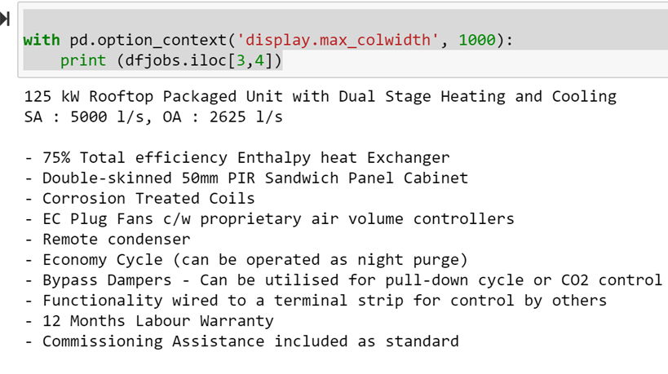
Data Set
Historical Costing Dataset
Regex to extract key information from descriptive text
- Capacity (kW)
- Airflow (l/s)
- Economy Option
Data, Cleaning and Feature Engineering
Add additional features
- Completed Date (age)
- Part Group
Converted null values
Merged costs from jobs table
Remove outliers
Normalise data
Create dummy variables
8

Slide 9
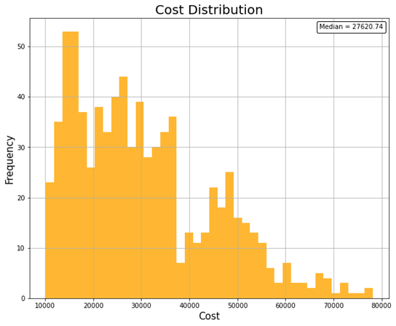
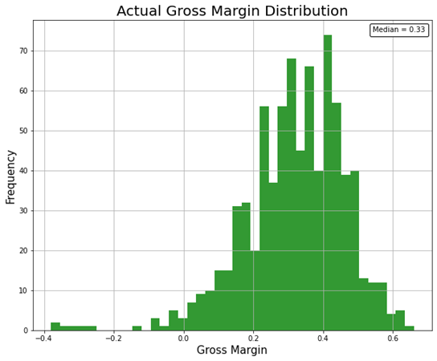

EDA
Cost and GM% Distribution 5 Year
9

Slide 10
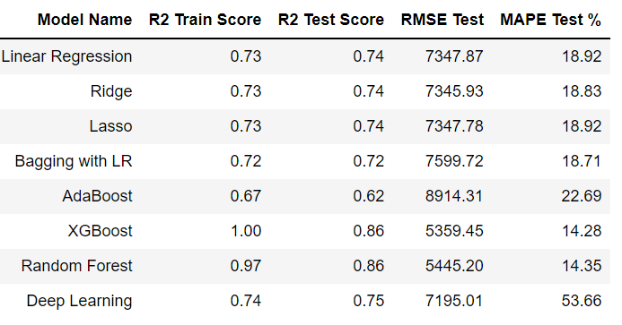
Machine Learning Results
Choose XG boost as it has the best performance
10

Slide 11
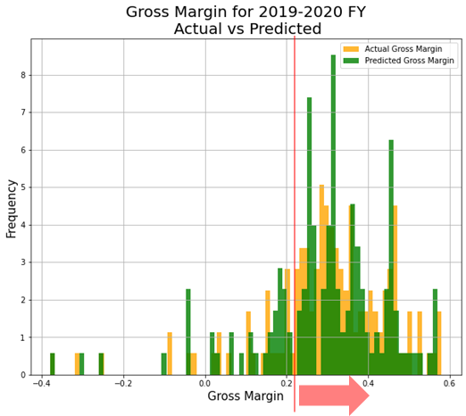
Results
Applying the Model
Apply the model to a specific financial year (2019-2020 FY) to predict cost and gross margin
Choose threshold for minimum GM = 0.2 (reasoning explained later)
Select only projects with predicted GM greater than threshold to simulate how the model would work in practice
Evaluate new GP, GM, savings in labour hours (providing additional production capacity)
11

Slide 12
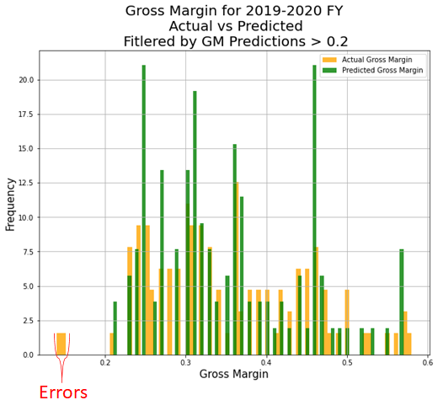
Results
Gross Margin Actual Versus Predicted
12

Slide 13
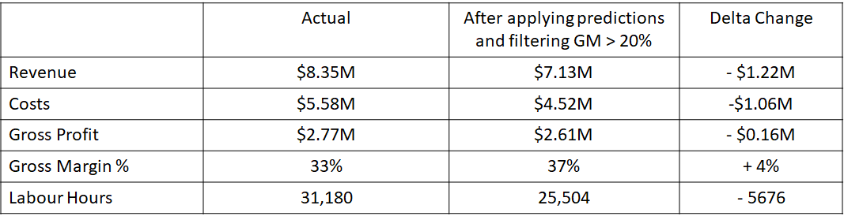
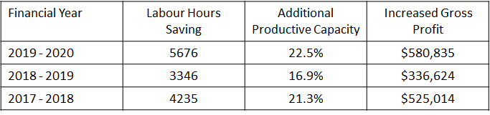
Results
2019-2020 Financial Year
Save 5676 labour hours by selecting only ‘good projects’
Represents a 22.25% increase in available production capacity
Assuming other orders can be taken at the average gross margin, the new gross profit would be $3.18M which is a $580,835 improvement
There are additional benefits
- Lower working capital
- Less overhead
Scalable
13

Slide 14
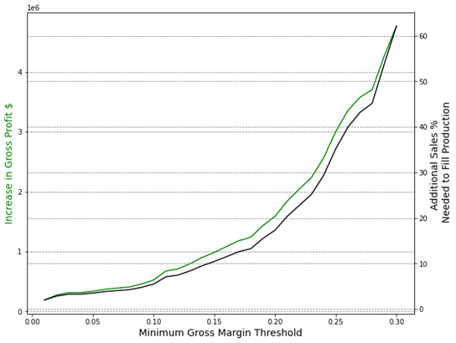
Results
GM Threshold 2017-2021
GP increases with greater GM threshold
Need to be able to replace rejected orders with others, limited by potential sales
Data can be created to calculate this limit by tracking lost orders specifically due to the inability to produce on time.
Assume 15% additional sales with experience, intuition and guessing.
Equivalent to a margin criteria of approximately 0.2
14

Slide 15
CONCLUSION AND FUTURE DEVELOPMENTS
Equipment costs can be estimated using machine learning models
Accurate costings can increase profits by eliminating poor projects
Need to investigate under/overpricing on yet to be awarded projects
Place more engineering rules in constructing the model to improve accuracy
15

Slide 16






























Thankyou

